Slide 1
Event-Driven Programming

Slide 2
Procedural vs. Event-Driven Programming
Procedural programming is executed in procedural order.
In event-driven programming, code is executed upon activation of events.

Slide 3
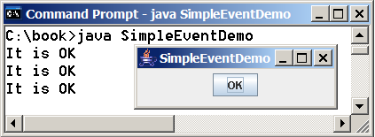
Taste of Event-Driven Programming
The example displays a button in the frame. A message is displayed on the console when a button is clicked.
SimpleEventDemo

Slide 4
Events
An event can be defined as a type of signal to the program that something has happened.
The event is generated by external user actions such as mouse movements, mouse clicks, and keystrokes, or by the operating system, such as a timer.

Slide 5
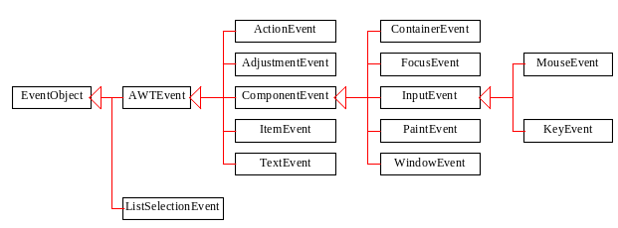
Event Classes

Slide 6
Selected User Actions
Source Event Type
User Action Object Generated
Click a button JButton ActionEvent
Click a check box JCheckBox ItemEvent, ActionEvent
Click a radio button JRadioButton ItemEvent, ActionEvent
Press return on a text field JTextField ActionEvent
Select a new item JComboBox ItemEvent, ActionEvent
Window opened, closed, etc. Window WindowEvent
Mouse pressed, released, etc. Component MouseEvent
Key released, pressed, etc. Component KeyEvent

Slide 7
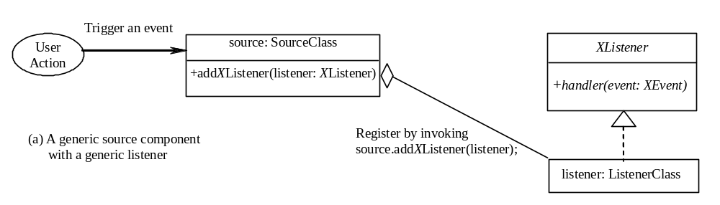
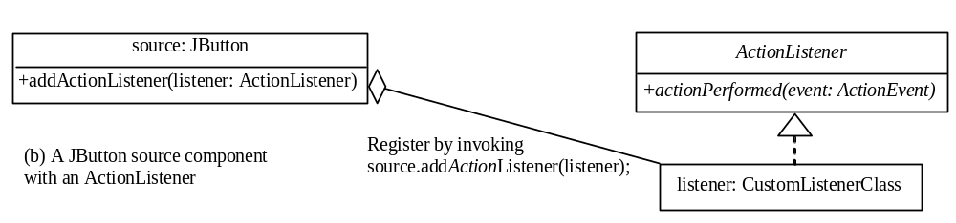
The Delegation Model

Slide 8
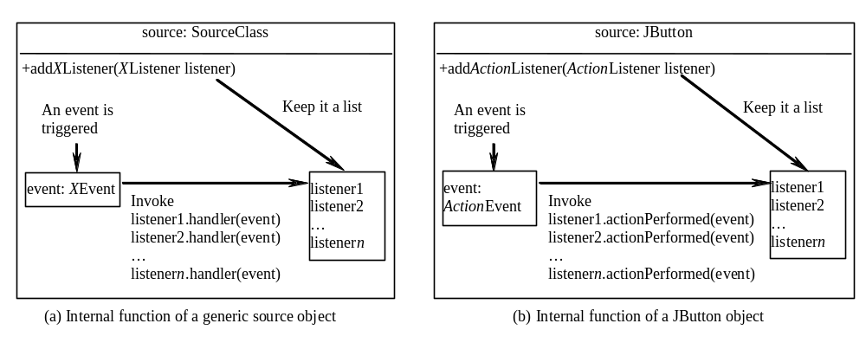
Internal Function of a Source Component

Slide 9
The Delegation Model: Example
JButton jbt = new JButton("OK");
ActionListener listener = new OKListener();
jbt.addActionListener(listener);

Slide 10
Selected Event Handlers
Event Class Listener Interface Listener Methods (Handlers)
ActionEvent ActionListener actionPerformed(ActionEvent)
ItemEvent ItemListener itemStateChanged(ItemEvent)
WindowEvent WindowListener windowClosing(WindowEvent)
windowOpened(WindowEvent)
windowIconified(WindowEvent)
windowDeiconified(WindowEvent)
windowClosed(WindowEvent)
windowActivated(WindowEvent)
windowDeactivated(WindowEvent)
ContainerEvent ContainerListener componentAdded(ContainerEvent)
componentRemoved(ContainerEvent) MouseEvent MouseListener mousePressed(MouseEvent)
mouseReleased(MouseEvent)
mouseClicked(MouseEvent)
mouseExited(MouseEvent)
mouseEntered(MouseEvent)
KeyEvent KeyListener keyPressed(KeyEvent)
keyReleased(KeyEvent)
keyTypeed(KeyEvent)

Slide 11
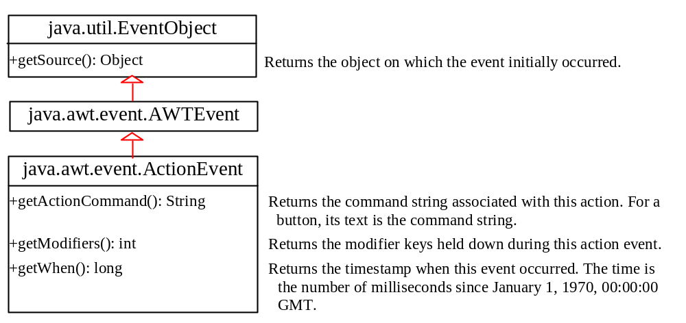
java.awt.event.ActionEvent

Slide 12
Inner Class Listeners
A listener class is designed specifically to create a listener object for a GUI component (e.g., a button). It will not be shared by other applications. So, it is appropriate to define the listener class inside the frame class as an inner class.

Slide 13
Inner Classes
Inner class: A class is a member of another class.
Advantages: In some applications, you can use an inner class to make programs simple.
An inner class can reference the data and methods defined in the outer class in which it nests, so you do not need to pass the reference of the outer class to the constructor of the inner class.
ShowInnerClass

Slide 14
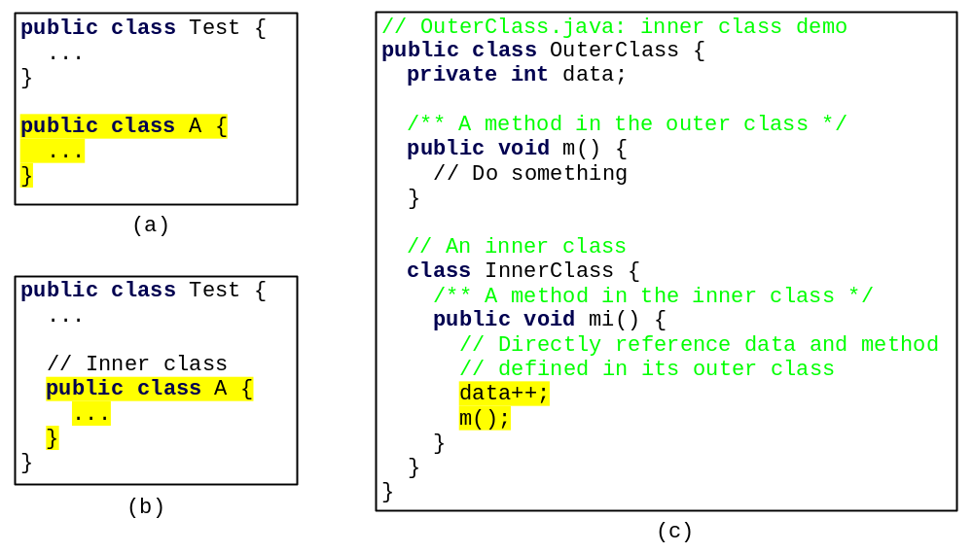
Inner Classes, cont.

Slide 15
Example: Handling Simple Action Events
Objective: Display two buttons OK and Cancel in the window. A message is displayed on the console to indicate which button is clicked, when a button is clicked.
TestActionEvent

Slide 16
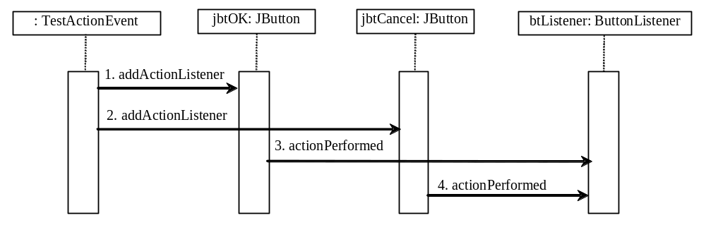
Interaction Between Source and Listener
  jbtOK registers btListener by invoking addActionListener(btListner).
  jbtCancel registers btListener by invoking addActionListener(btListner).
  jbtOK invokes btListener’s actionPerformed method to process an ActionEvnet.
  jbtCancel invokes btListener’s actionPerformed method to process an ActionEvent.

Slide 17
Example: Handling Window Events
Objective: Demonstrate handling the window events. Any subclass of the Window class can generate the following window events: window opened, closing, closed, activated, deactivated, iconified, and deiconified. This program creates a frame, listens to the window events, and displays a message to indicate the occurring event.
TestWindowEvent

Slide 18
Handling Mouse Events
Java provides two listener interfaces, MouseListener and MouseMotionListener, to handle mouse events.
The MouseListener listens for actions such as when the mouse is pressed, released, entered, exited, or clicked.
The MouseMotionListener listens for
actions such as dragging or moving the
mouse.

Slide 19
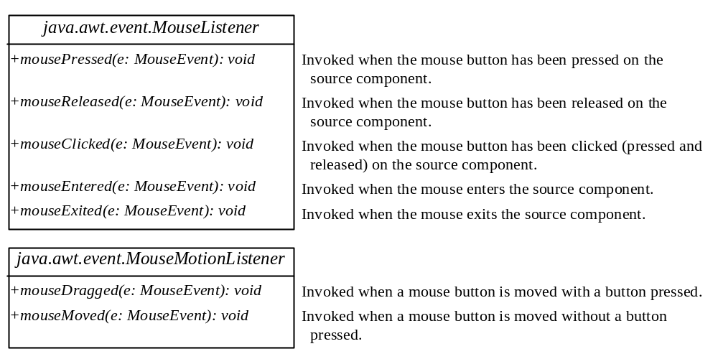
Handling Mouse Events

Slide 20
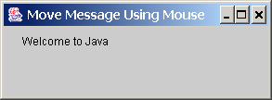
Example: Moving Message Using Mouse
Objective: Create a program to display a message in a panel. You can use the mouse to move the message. The message moves as the mouse drags and is always displayed at the mouse point.
MoveMessageDemo

Slide 21
Handling Keyboard Events
To process a keyboard event, use the following handlers in the KeyListener interface:
keyPressed(KeyEvent e)
Called when a key is pressed.
keyReleased(KeyEvent e)
Called when a key is released.
keyTyped(KeyEvent e)
Called when a key is pressed and then
released.

Slide 22
The KeyEvent Class
Methods:
getKeyChar() method
getKeyCode() method
Keys:
Home VK_HOME
End VK_END
Page Up VK_PGUP
Page Down VK_PGDN
etc...

Slide 23
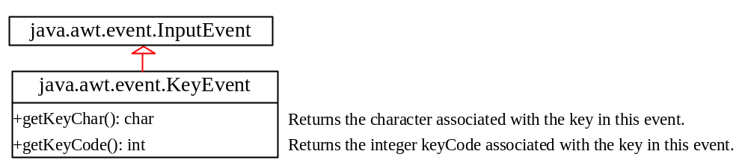
The KeyEvent Class, cont.

